Slide 1

MD Museum Learning & Engagement Grants – how GEM can support your museum
Rachel Tranter MBE
GEM Director
Robin Johnson – GEM Cymru Projects Lead

Slide 2

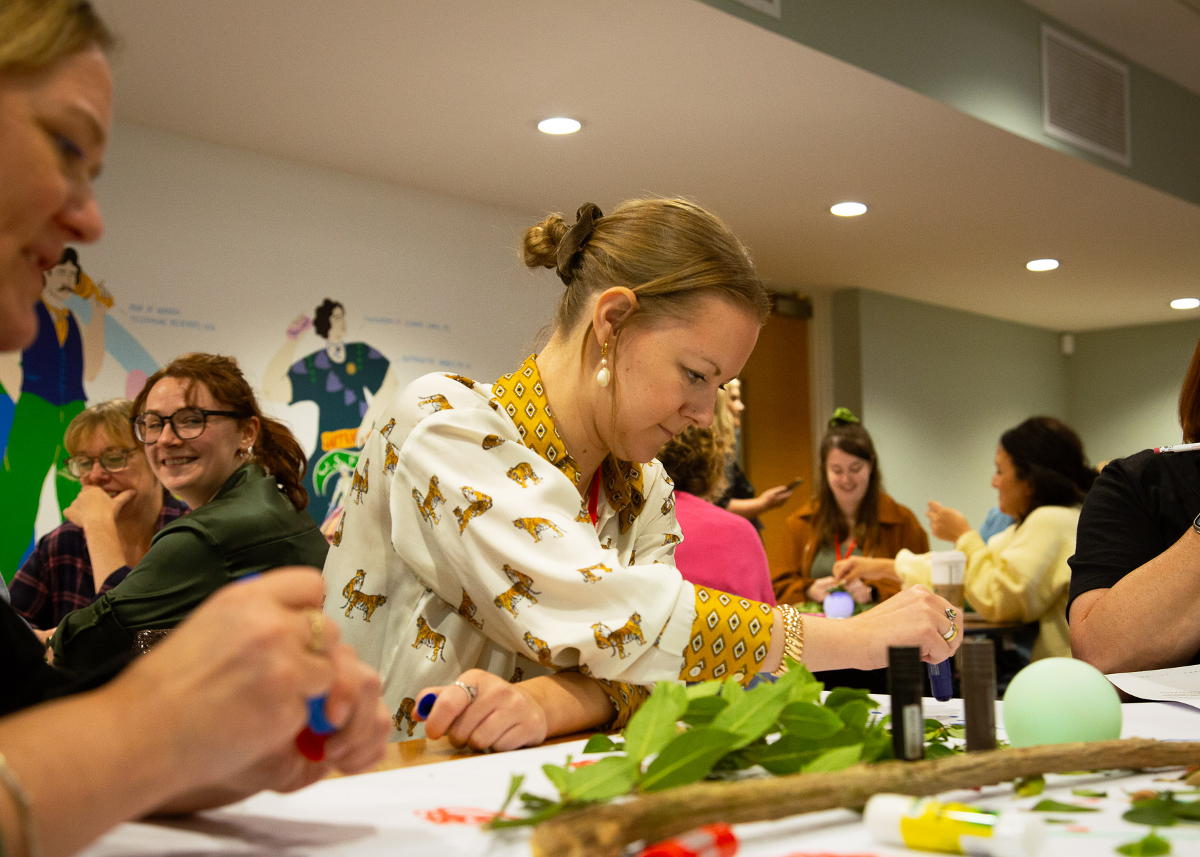
About GEM
GEM is a community of learning practitioners across museums, heritage and cultural settings
GEM Connects & Learns Together
Our VALUES are: Belonging, Collaborating, Empowering, Connecting, Expertise and Generosity
Our Vision is to support a connected and equipped community of people who create inspiring experiences, relevant for everyone; that promote equity – transform and enrich lives
GEM is an Arts Council England Investment Principles Support Organisation (IPSO)

Slide 3
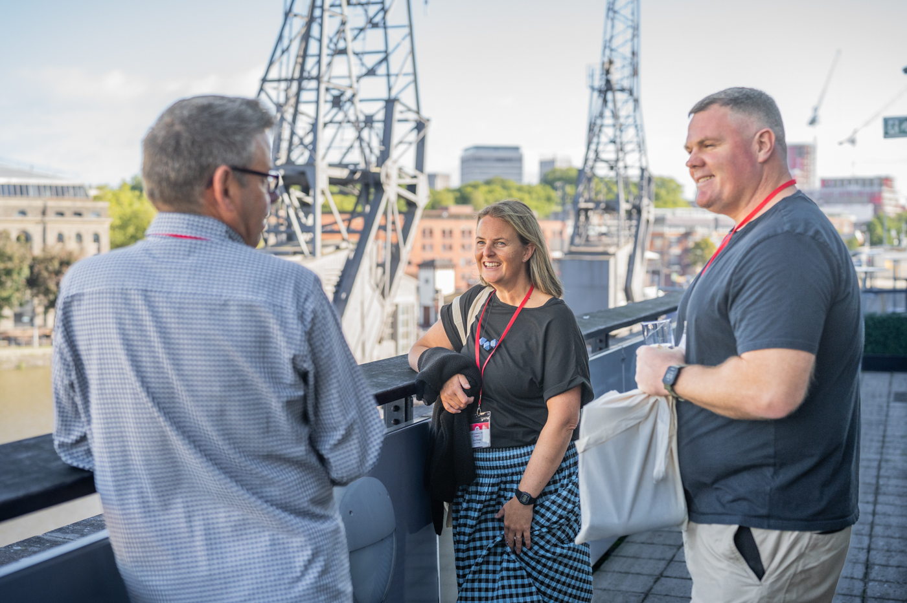
What support does GEM offer?
Events and training ​
Area, Nation and International programme​
Publications and Online resources​
Mentoring and competency framework​
Jobs noticeboard​
GEM JISCMail
GEM’s Annual Conference (Newcastle in 2027)

Slide 4
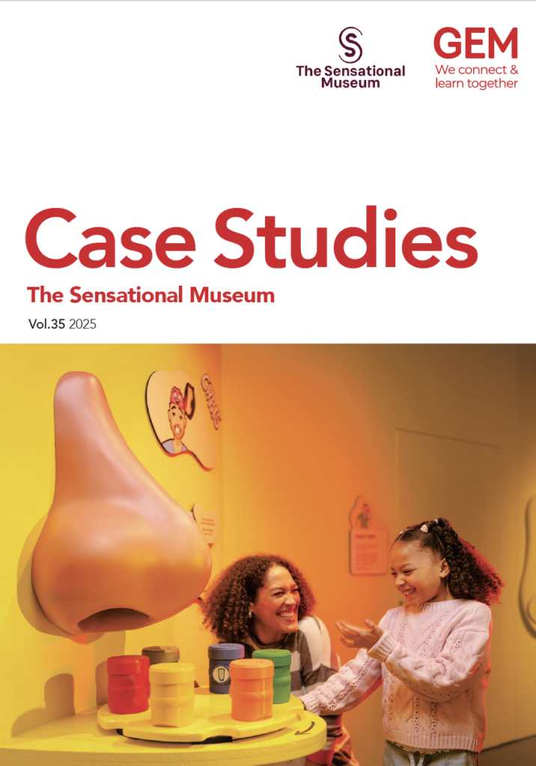

GEM Publications
https://gem.org.uk/our-work/publications/case-studies/
Case Studies #36 Learning Places launching soon!
Case Studies #35 The Sensational Museum
Case Studies #34 Career Pathways in Museum
JEM Journal – In Spite Of

Slide 5
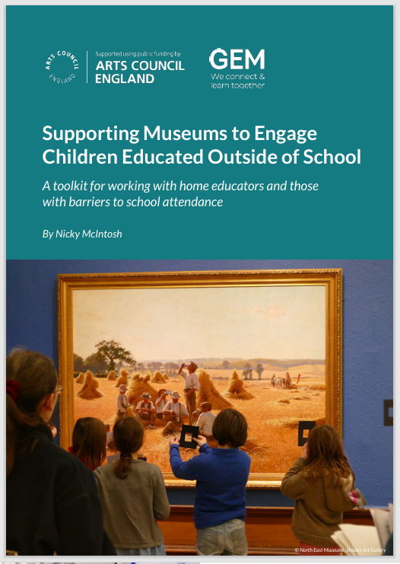
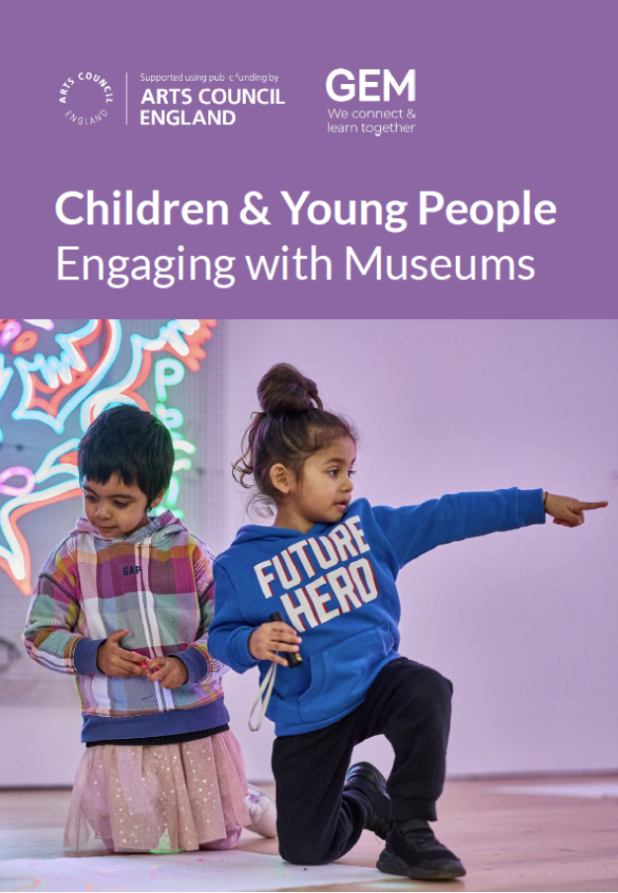
GEM Resources
Explore GEM’s selection of free resources, from check lists and templates to toolkits and case studies.
New resources: https://gem.org.uk/resource/
Refreshed GLOs Framework
Children and Young People Engaging with Museums
Supporting Museums to Engage Children Educated Outside of School
and much more!

Slide 6
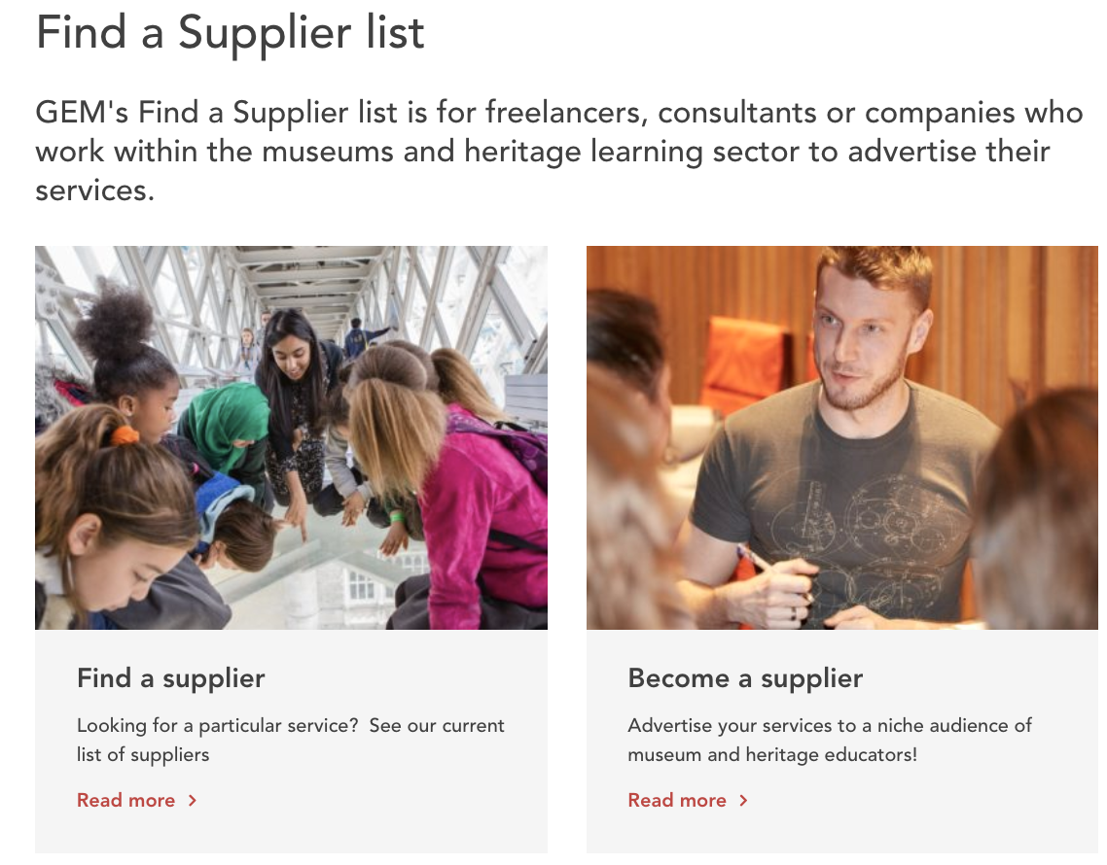
Supplier List
https://gem.org.uk/suppliers-listing/
80+ trusted suppliers specialising in a wide range of fields:
Design, evaluation, project management, comms & marketing.

Slide 7

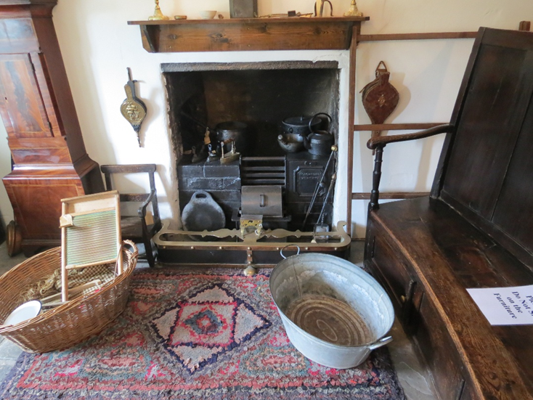
GEM Cymru Mentor scheme
Museums worked with an experienced Heritage Learning Professional over 5 days on a variety of projects, with an accompanying small grant.
Here are just some examples of the kind of projects that were developed in collaboration with an experienced heritage learning professional over the last few years.

Slide 8
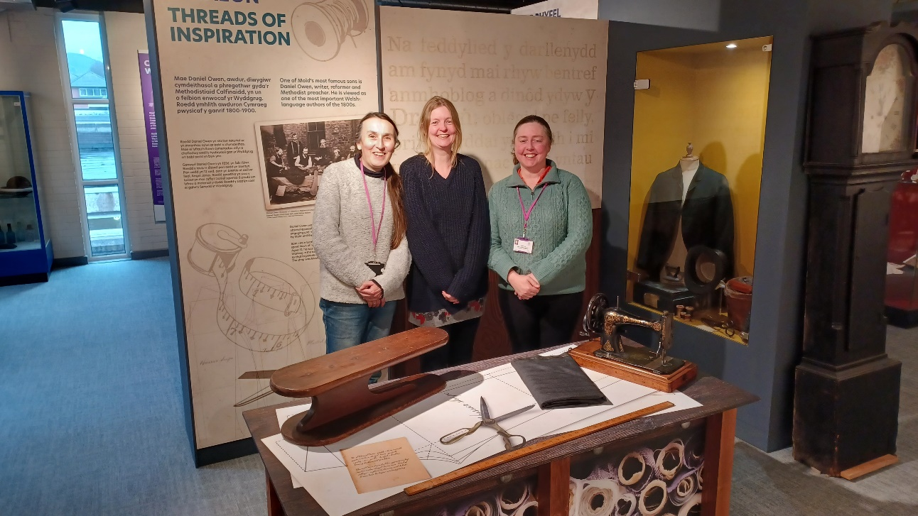

GEM Cymru Mentor scheme
Mold Museum worked with a freelancer to develop a new museum trail alongside brand new handling materials to be used by f.o.h. staff.
Rhondda Cynon Taff Museum worked with an experienced learning professional to produce an engaging and innovative promotional film for schools to engage with as marketing

Slide 9
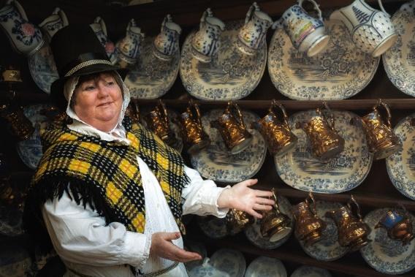
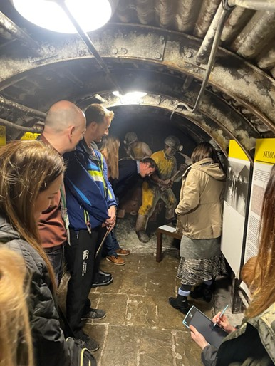
GEM Cymru Mentor scheme
Newtown textile Museum to develop a new activity box full of appropriate toys and games and ‘explorer bags’ to be used in the galleries.
Cyfarthfa Castle & Museum worked with an experienced learning professional to set up and run a new teacher's forum which helped them create teachers’ packs and notes for self led visits

Slide 10
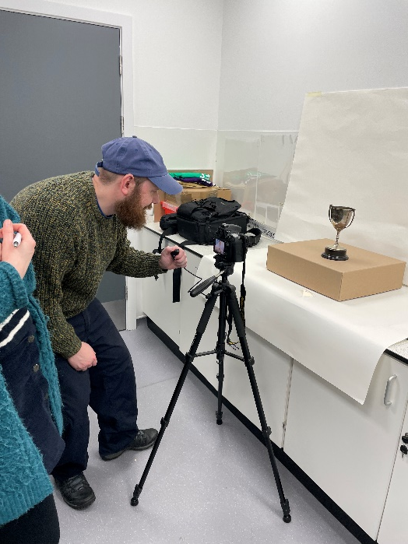
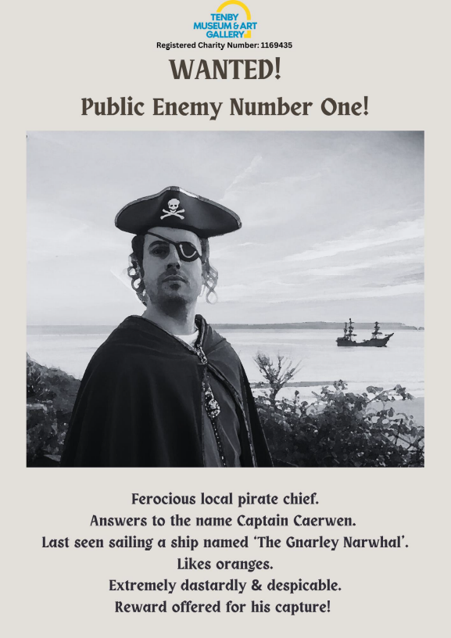
GEM Cymru Mentor scheme
Conwy Culture Centre worked with experienced freelancer who liaised with local schools to research the audience and their needs, resulting in new high quality, digital outreach service.
Tenby Museum worked with experience learning professional to create new living history drama session based on local pirates!

Slide 11
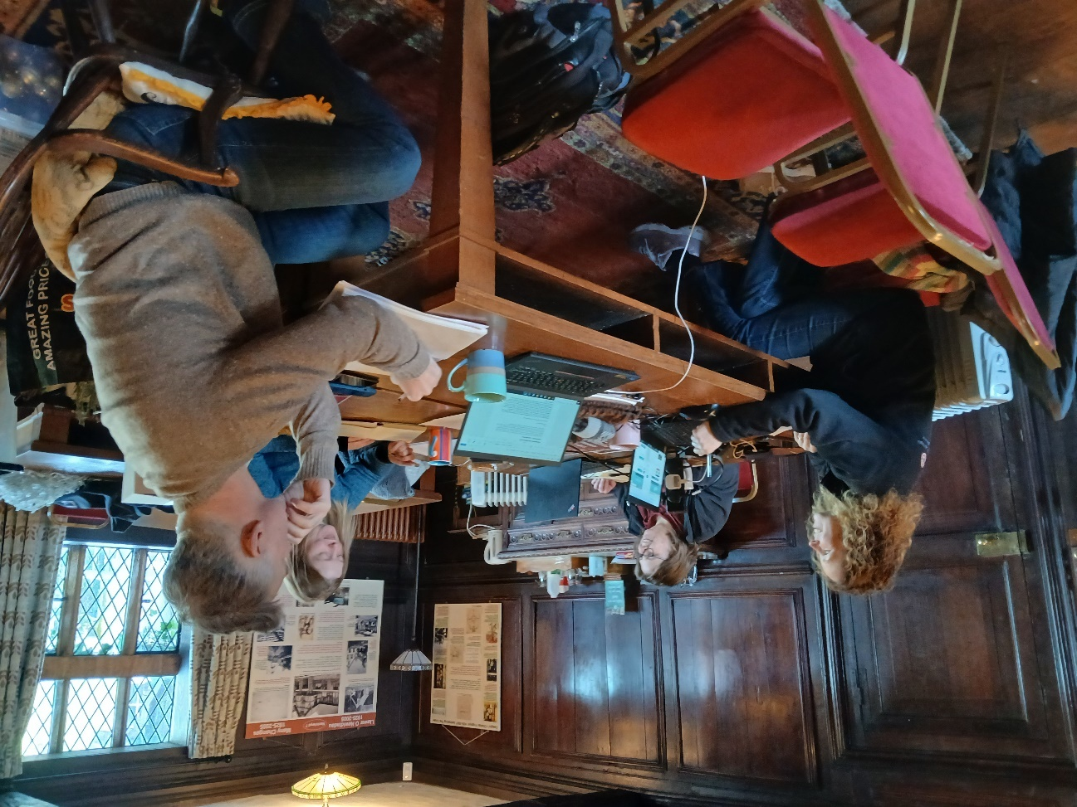
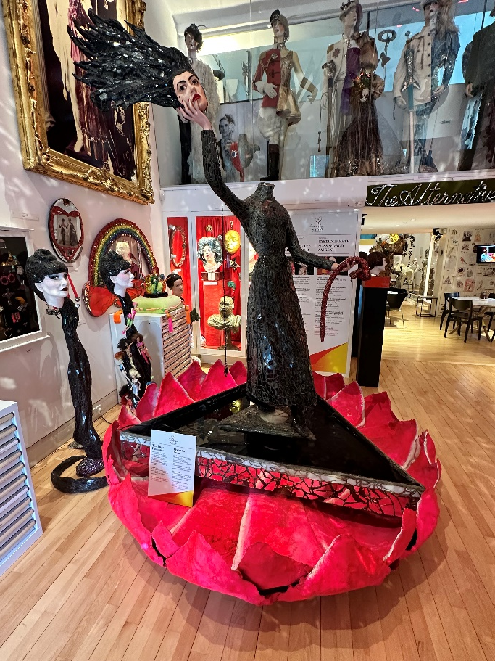
GEM Cymru Mentor scheme
Denbighshire worked with heritage freelancer to discuss new ways of working better, and more collaboratively, across their three sites with schools.
Andrew Logan Museum worked with an experienced museum professional to start their learning journey and create a brand new education service.

Slide 12
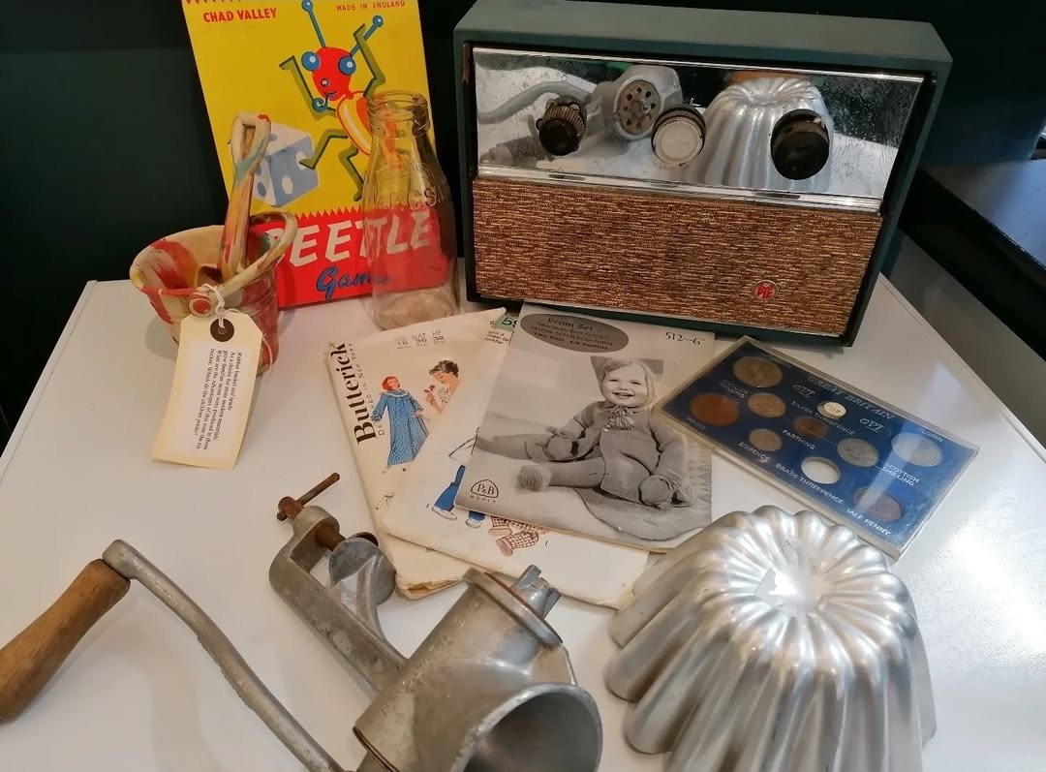
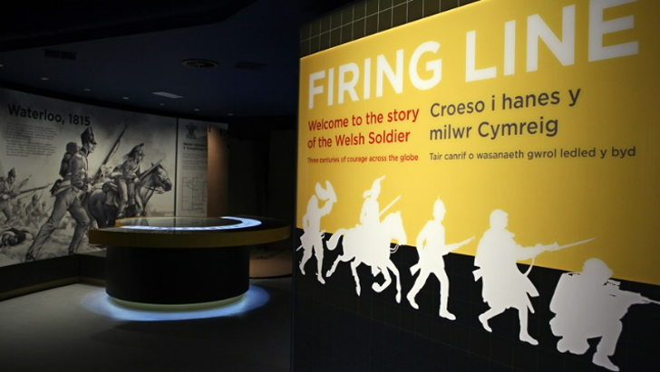
GEM Cymru Mentor scheme
Torfaen Museum worked with an experienced learning professional to develop more self led sessions alongside a brand new object based outreach service.
Firing Line – developed new 16-18 yr old appropriate materials and sessions after the experienced mentor worked with the f.o.h. team (who knew the audience best)

Slide 13

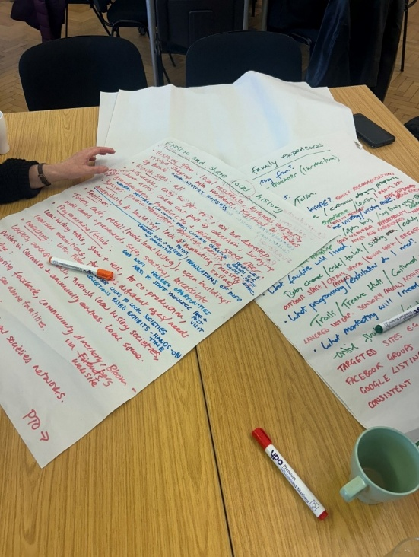
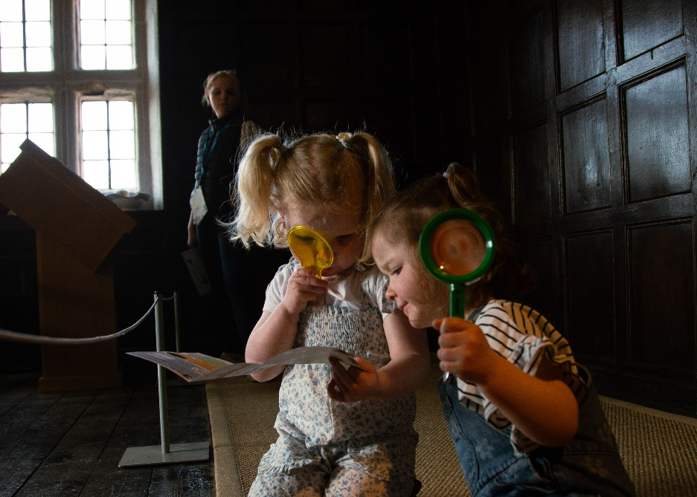
GEM Learning Places Programme
Influenced by the Welsh example, this was a pilot project in England whereby 2 museum services worked with highly experienced museum learning consultants to undergo an in-depth analysis of user needs alongside a radical rethink of learning policies and strategy with input and collaboration from the whole staff group, not just the education dept.

Slide 14
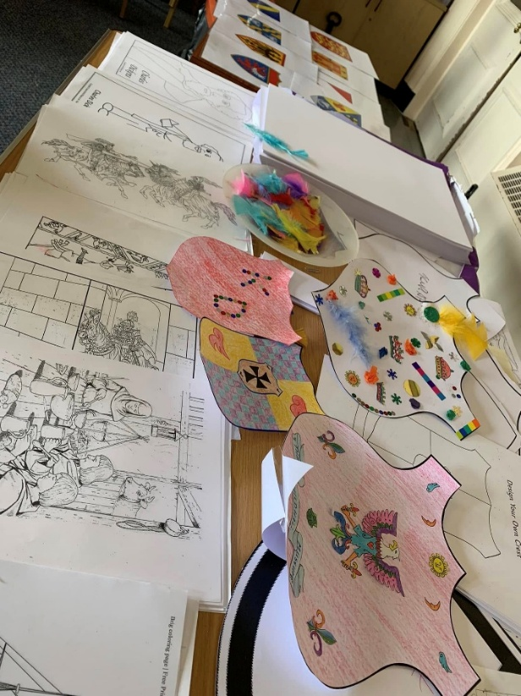
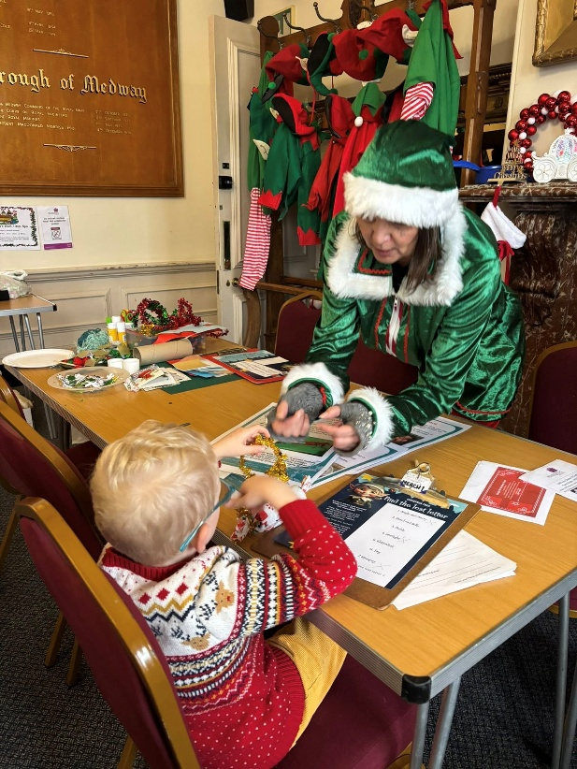
GEM Learning Places Programme
Rochester Guildhall Museum found that working with an external partner focused the minds of staff and led to museum staff having a clearer and more influential input into the direction of travel for learning. It encouraged collaborative thinking and reduced the reliance on one person. It created a space for constructive dialogue and exchange of ideas

Slide 15
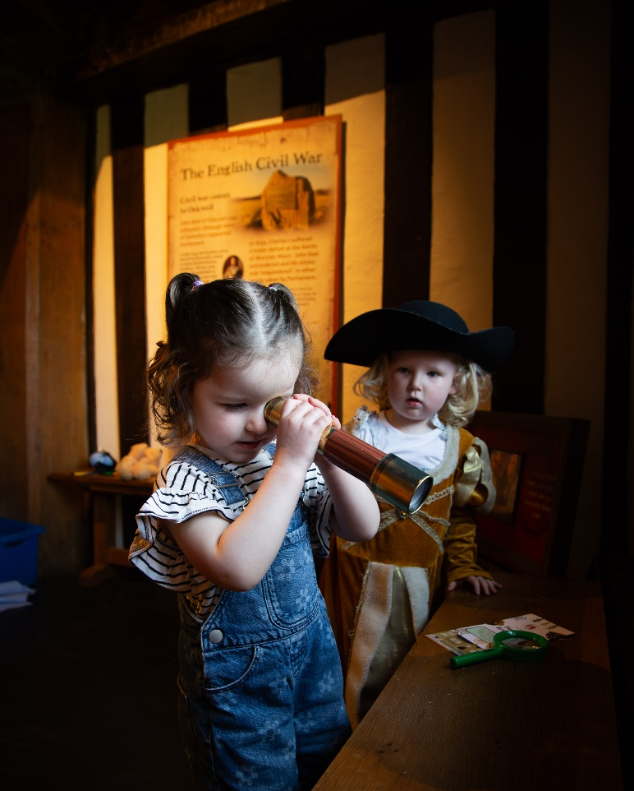
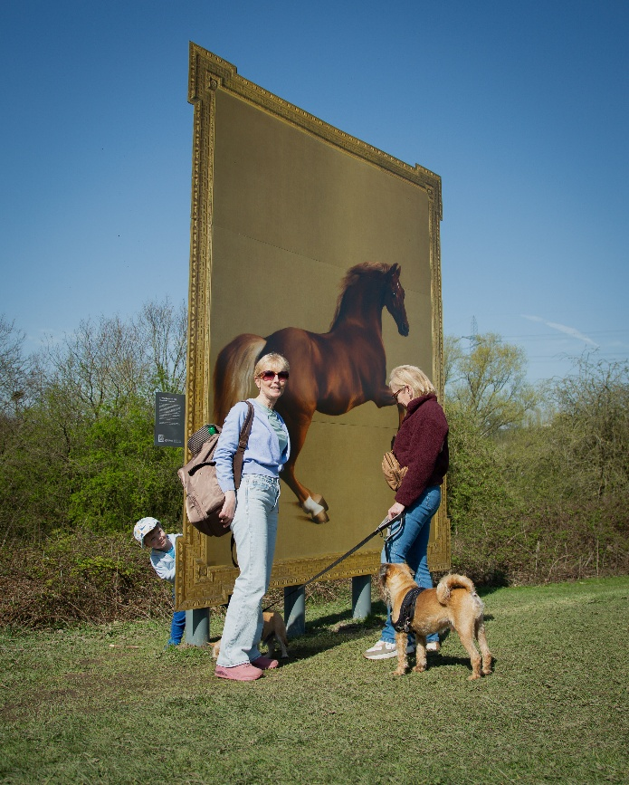
GEM Learning Places Programme
Kirklees Museum Service found that working with a ‘critical friend’ was a refreshing change and enabled honest feedback and opinion giving. It created a shared sense of purpose and ownership.
“It helped to unpack stagnant systems by reenergising staff through practical advice”

Slide 16
Working with freelancers
Develop a clear brief
Provide your freelancer with the information they need
Agree any changes jointly
Be open to listen to the advice provided
Credit the freelancer with work completed
Evaluate (GLO framework useful model)
Involve your freelancer in celebrating the project successes

Slide 17
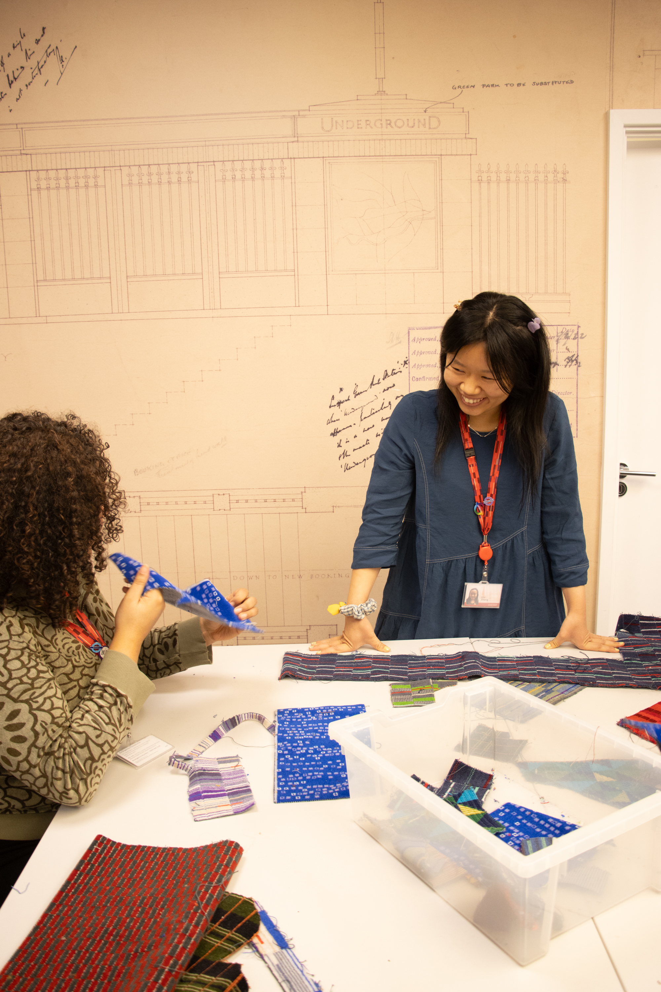
GEM Training
Learning Strategy webinar
Foundation Course: Museum Learning
Heritage Interpretation
Accessible Interpretation in Practice
Fundraising for Museum Learning
Emerging Leaders
Engaging with Schools: From Planning to Evaluation
Museum Basics
Career Reset
Health & wellbeing
SEND

Slide 18
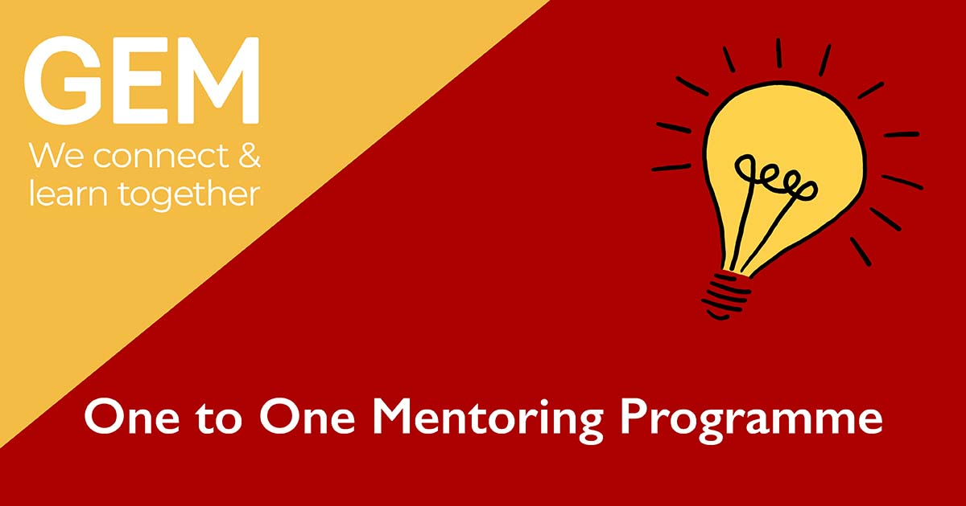

Slide 19


