Slide 1
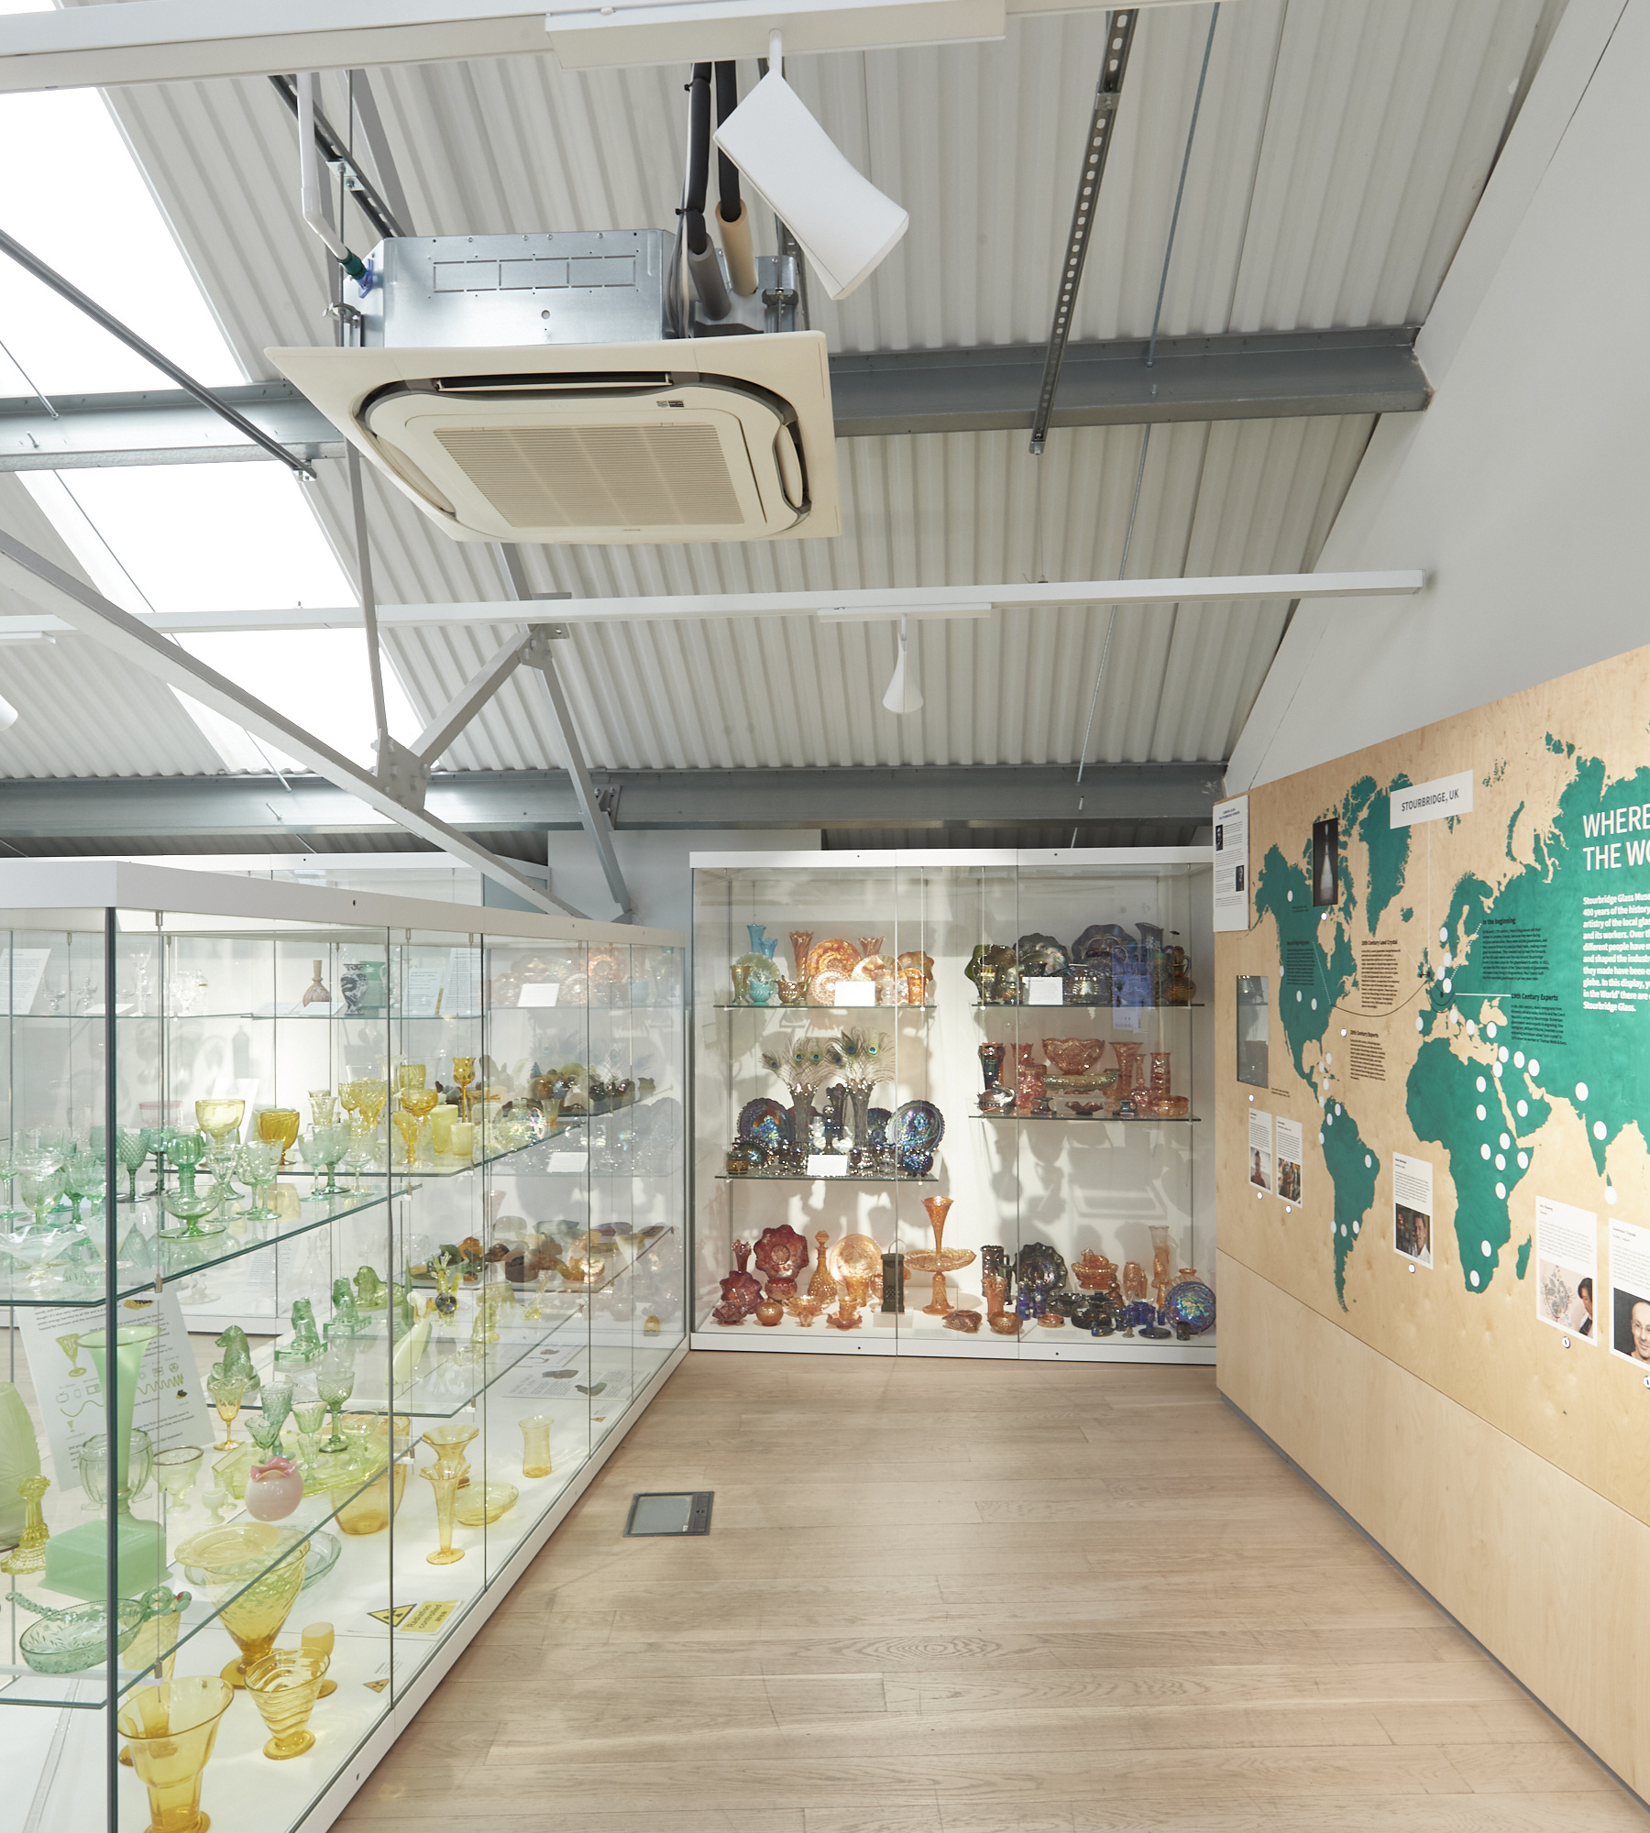
Local Government Reorganisation (LGR):
A readiness checklist for museums
Stourbridge Glass Museum (2026). Photo: A Shot in the Dark

Slide 2
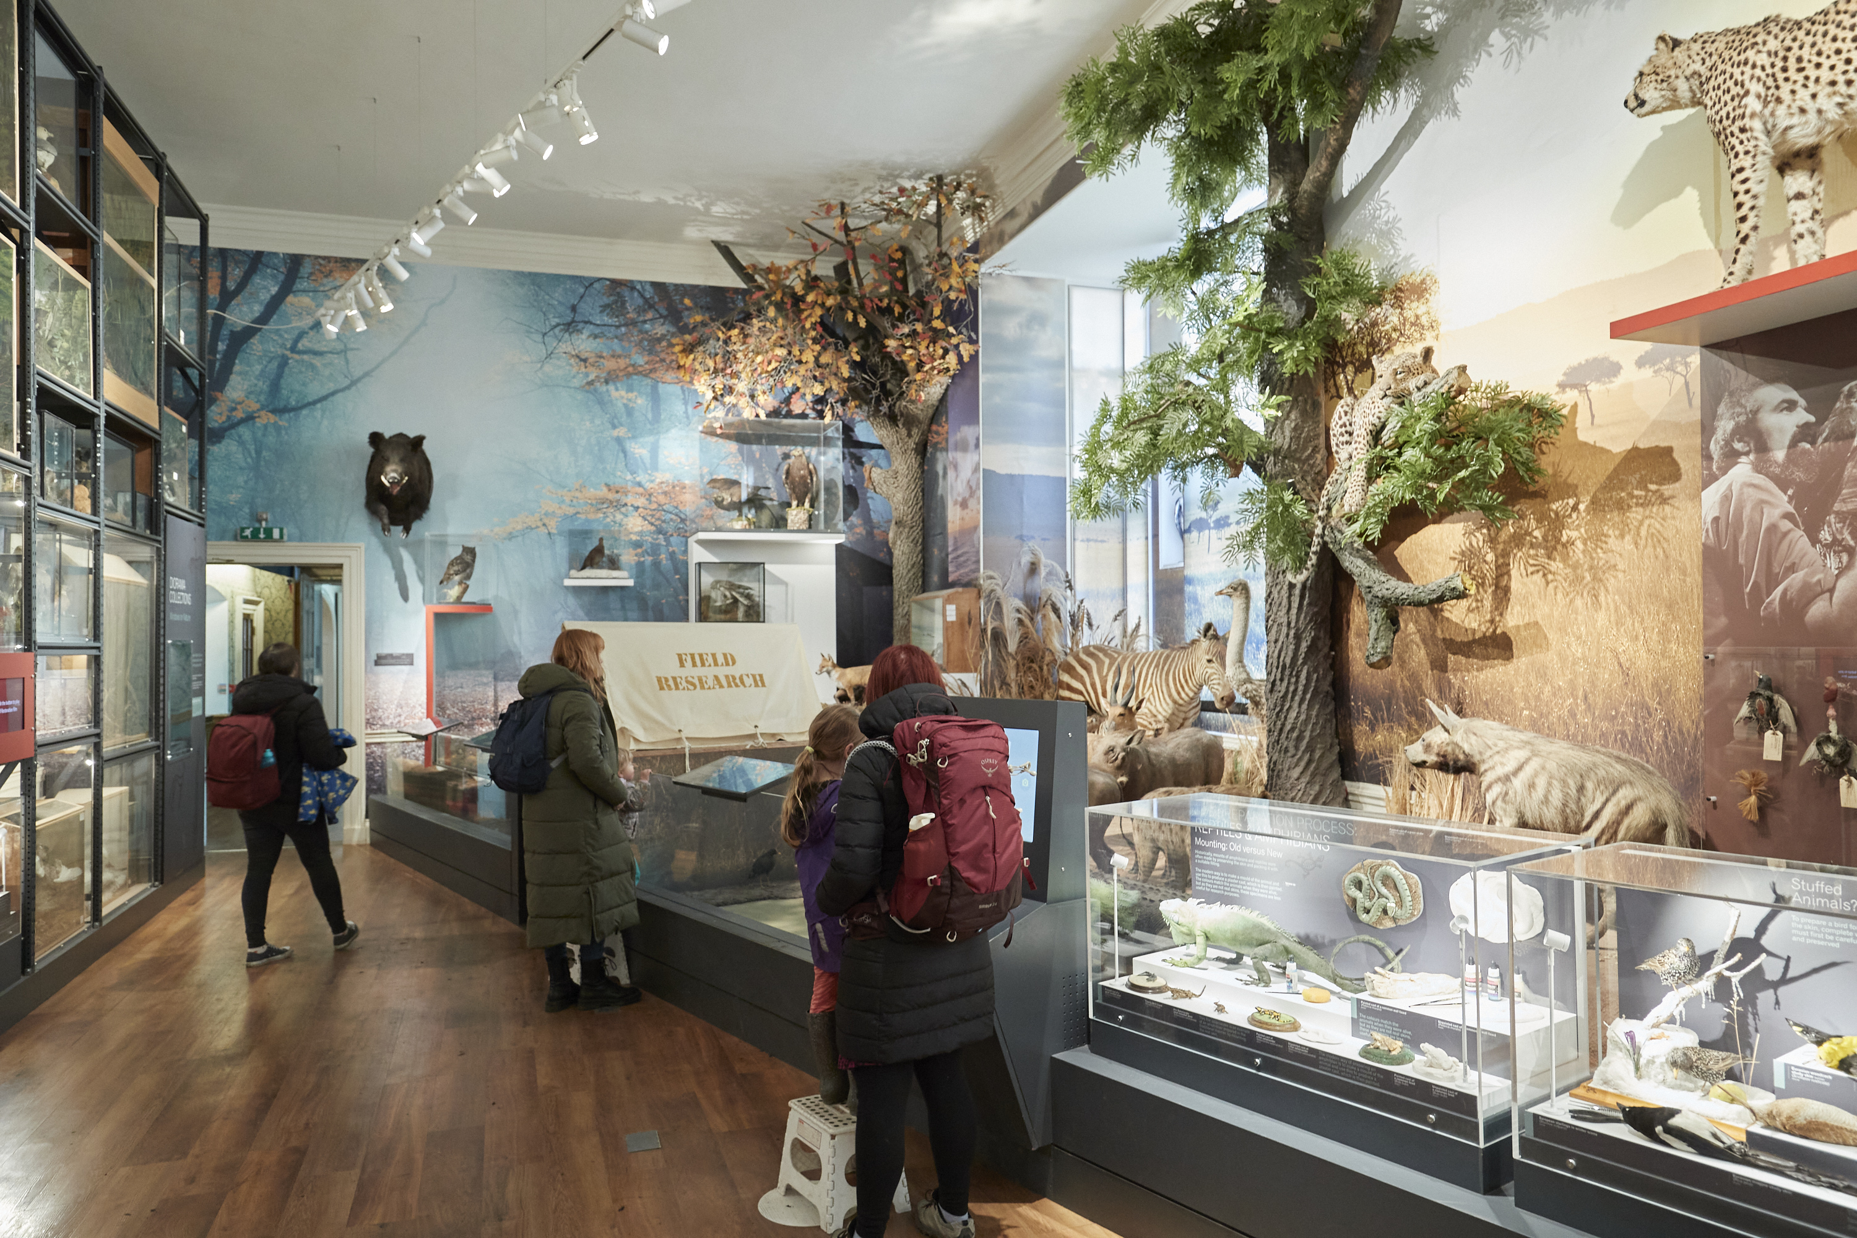
Introduction
Purpose of the checklist
What is local government reorganisation?
Where is it happening?
A note on devolution
Timeline
Wollaton Hall (2026). Photo: A Shot in the Dark Photography.

Slide 3
Purpose of the checklist
This checklist has been commissioned by Arts Council England to provide practical guidance to museums in England who are affected by local government reorganisation.
It is intended to complement the wider support offered by Museum Development teams and Relationship Managers.
Although the exact situation in every local authority and every museum will be different, the checklist is intended to be useful to all.
The primary audience for the checklist is local authority owned and operated museums but there is also guidance for independent and local authority reliant museums who will be impacted by the changes.

Slide 4
Tools to support you
The ‘readiness checklist’ for museums includes:
  These slides (PowerPoint)
  A checklist document (Word)
  Service data audit questions and audit table (Word)
  A ‘useful resources’ document for further reading (Word).
  NB the publication Guidance for Libraries and Archives on Local Government Reorganisation also contains useful and relevant information for museums.
  MD briefing workshop recording

Slide 5
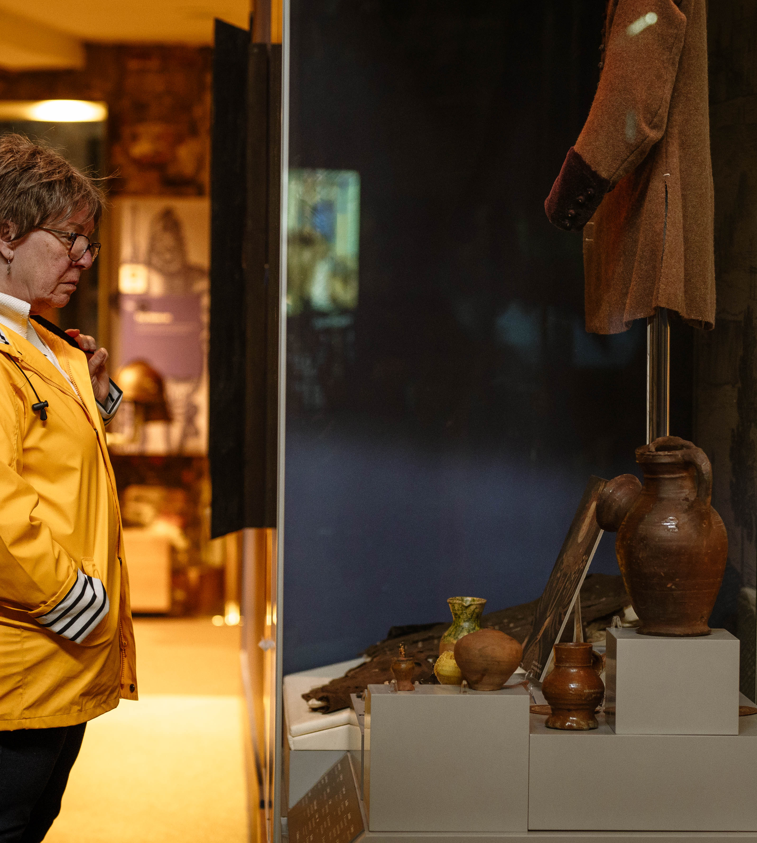
What is Local Government Reorganisation?
And what does it aim to achieve?
Colchester Castle (2026). Photo: Chloe Hashemi.
Artonik Bell Square © Vipul Sangoi

Slide 6
What is LGR?
The English Devolution and Community Empowerment Bill (2025) sets out plans to reconfigure and restructure local authorities to move away from the current two-tier system of district and county councils.
In February 2025, all English councils in two-tier areas (and some small neighbouring unitary authorities) were formally invited by the Ministry of Housing, Communities and Local Government (MHCLG) to submit proposals for LGR.
The aim is to implement efficient and high-quality local government structures for public service delivery using a ‘unitary’ (single tier responsible for all services) approach.
Shobana Jeyasingh – Seniors Workshop © Jason Thompson

Slide 7
Scale of LGR
This will require the merger of council offices and functions, affecting 164 district councils and the 21 county councils that sit above them.
These changes will affect 19.7 million residents in England (34.1% of the population).
The government has also formally invited a further 19 areas that currently have a unitary authority to reorganise, which would see their services merged with that of their neighbouring district councils. These areas represent almost 4.1 million residents in England (7.1% of the population).
Shobana Jeyasingh – Seniors Workshop © Jason Thompson

Slide 8
Where is LGR happening?
Cambridgeshire & Peterborough
Derbyshire and Derby
Devon, Plymouth and Torbay
East Sussex and Brighton
Essex, Southend on Sea and Thurrock
Gloucestershire
Hampshire, Isle of Wight, Portsmouth and Southampton
Hertfordshire
Kent & Medway
Lancashire, Blackburn & Blackpool
Leicestershire, Leicester & Rutland
Lincolnshire, North Lincolnshire & NE Lincolnshire
Norfolk
Nottinghamshire & Nottingham
Oxfordshire
Staffordshire & Stoke-on-Trent
Suffolk
Surrey
Warwickshire
West Sussex
Worcestershire
Shobana Jeyasingh – Seniors Workshop © Jason Thompson

Slide 9
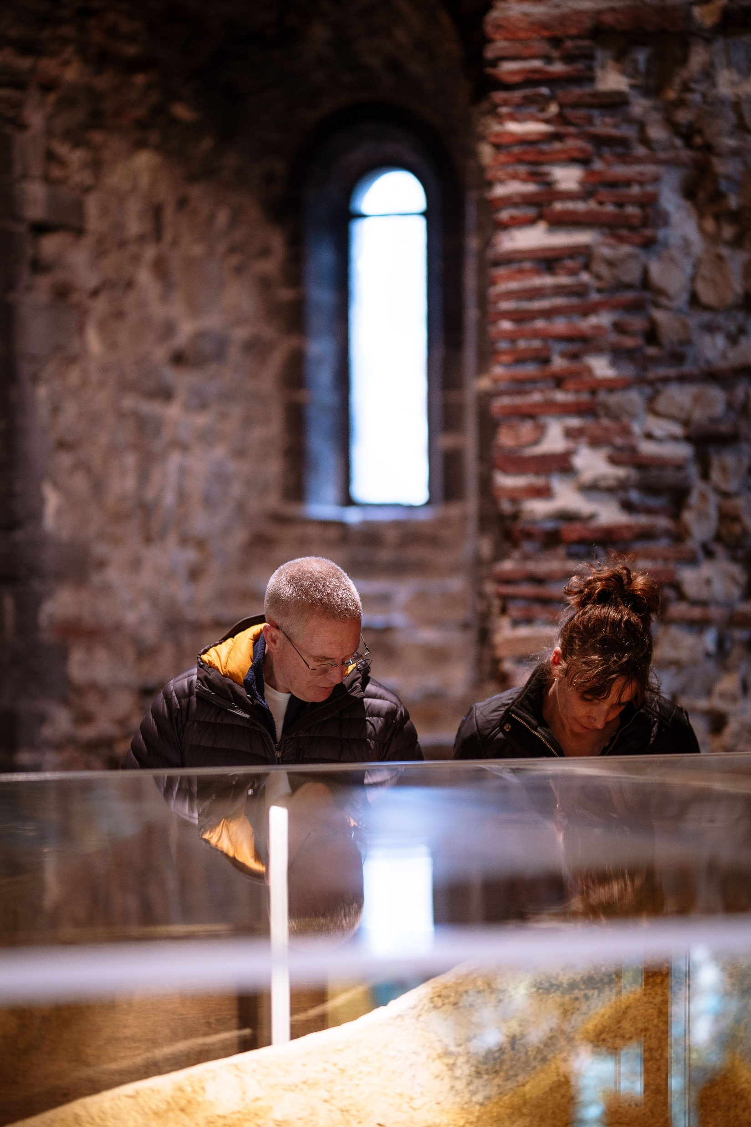
A note on devolution…
The legislation also sets out a Devolution Priority Programme (DPP) which establishes new Strategic Authorities (SA) across a number of member councils to be more ambitious on joint working around devolved powers (eg transport).
This checklist does not focus on devolution but strategic authorities will have powers around culture so it is a relevant issue for museums to proactively engage with.
Shobana Jeyasingh – Seniors Workshop © Jason Thompson
Colchester Castle (2026). Photo: Chloe Hashemi.

Slide 10
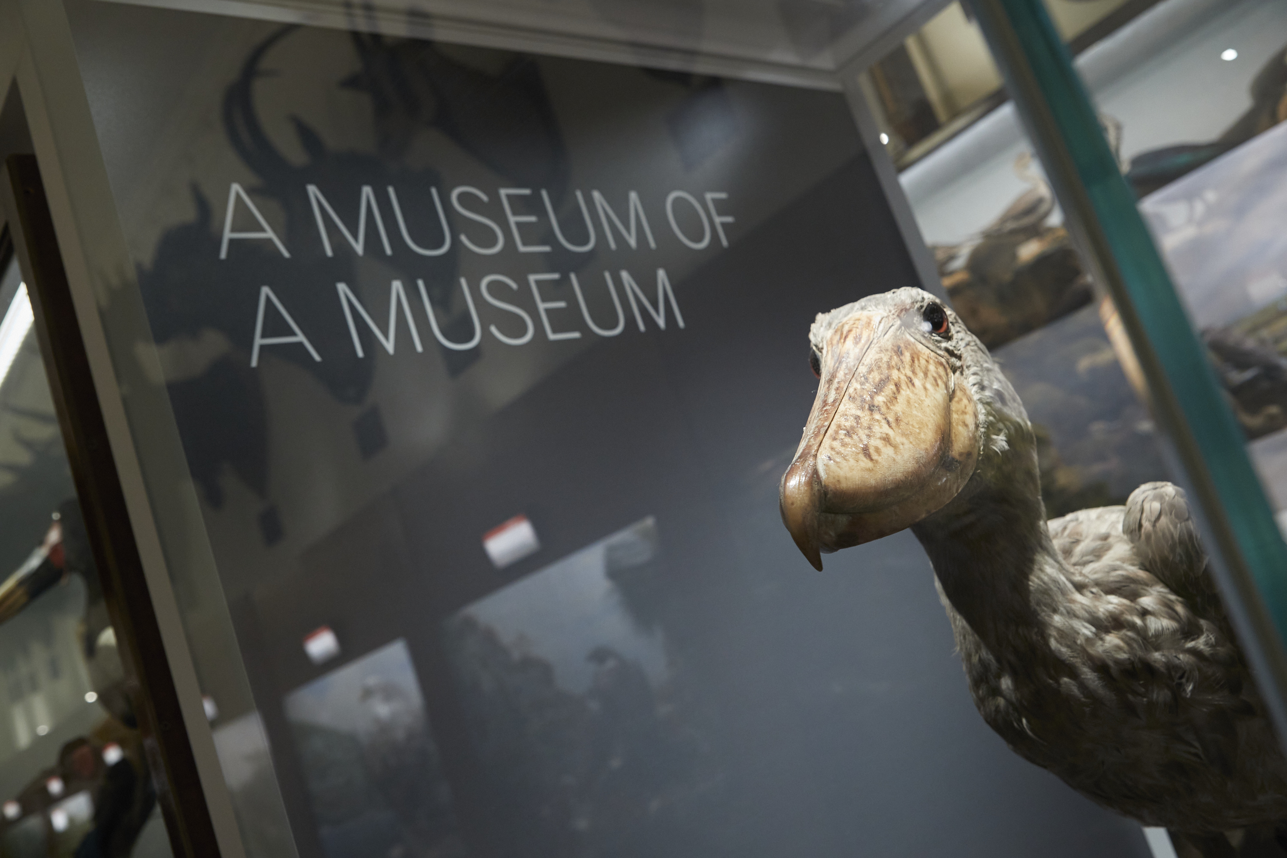
Timeline
All authorities will be told what the new council boundaries and groupings will be by Summer 2026 (devolution ‘priority area’ decisions were announced in March 2026).
Authorities will hold elections for the shadow authorities in May 2027.
The new councils will go live from 1 April 2028 “vesting day”.
LGR in Surrey is working to a shorter timeline with shadow elections in May 2026 with the new councils going live on 1 April 2027.
Wollaton Hall (2026). Photo: A Shot in the Dark Photography.
Shobana Jeyasingh – Seniors Workshop © Jason Thompson

Slide 11
Getting ready
The process of Local Government Reorganisation will take place over several years.
It is a huge process of change for how council services are delivered. There will be challenges AND opportunities for museums.
Because museums are non-statutory services, they can be vulnerable during restructuring as new unitary authorities prioritise statutory duties. There will be lots of elements that you have no control over
BUT there are things that museum services can proactively plan for now and in the months and years ahead
It is a marathon, not a sprint! Vesting day is another start point.
Shobana Jeyasingh – Seniors Workshop © Jason Thompson

Slide 12
Readiness checklist for museums
Be part of the planning process
Carry out a service data audit
Identify risks
Manage change: workforce support
Manage change: stakeholder relationships
Advocacy
Ensure compliance with external standards
Plan for the future/ museum specifics
Get support
Support for museums who are not operated by a local authority
Shobana Jeyasingh – Seniors Workshop © Jason Thompson

Slide 13
Who should use the checklist?
The main checklist is designed to help local authority owned and operated museums ready themselves for Local Government Reorganisation in England.
There is a specific checklist action for independent museums (who have a relationship with their local authority) and local authority reliant museums to use.
Arts Council England defines local authority reliant museums as ‘if the local authority were to withdraw its support or provision it would significantly impact on the museum's ability to deliver its current operations’.
Shobana Jeyasingh – Seniors Workshop © Jason Thompson

Slide 14
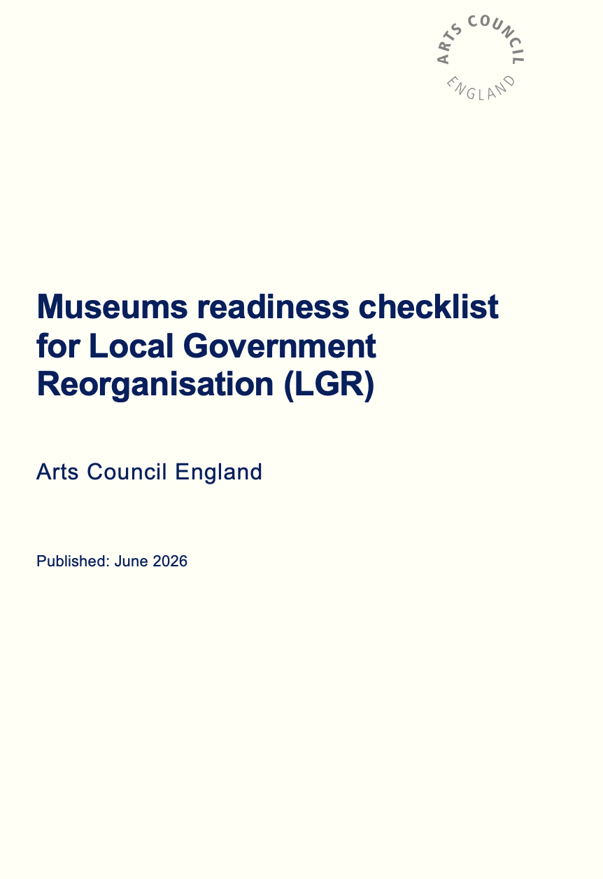
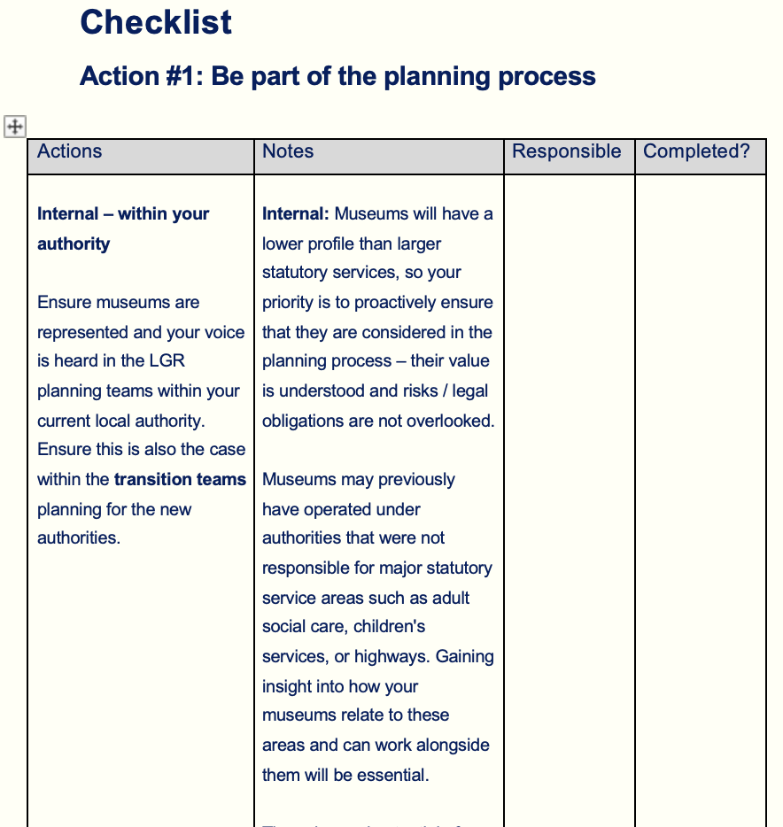
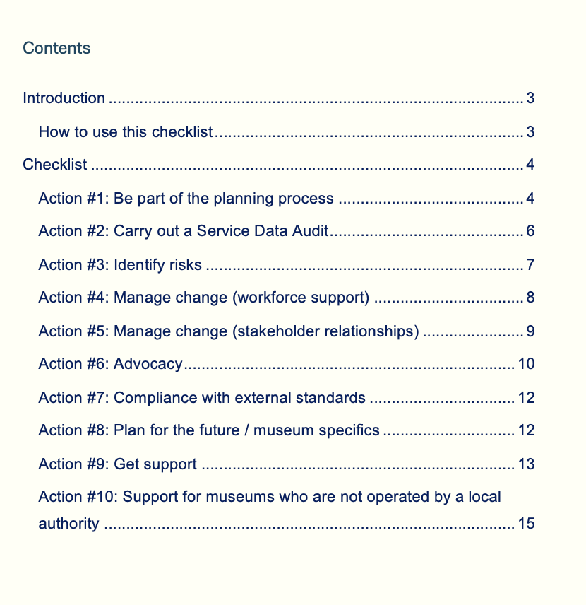
Shobana Jeyasingh – Seniors Workshop © Jason Thompson

Slide 15
1. Be part of the planning process
There is a huge amount of planning for new services to be done. This will start in your current authority, before transition teams will be set up for the new authorities.
Start to talk to neighbouring museum services* so you understand each other’s services and can consider what might work best for your services if you are working together in the future.
Is there anyone in your team / network who has been through LGR before? Can they help/advise?
Who are your champions in your existing authority? And / or in the new authority?
Shobana Jeyasingh – Seniors Workshop © Jason Thompson

Slide 16
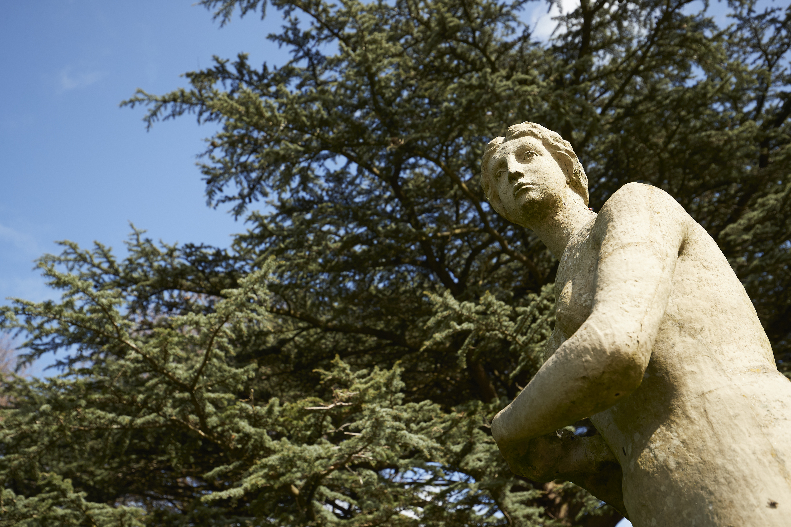
2. Service data audit
It is essential that you can provide detailed information on the scope and scale of your service to feed into planning teams and to share with (new) colleagues.
We have provided a document with suggested questions and an audit table for you to collate the data.
Carry this out as soon as you can and update as needed. Work with colleagues and draw on data from the Museum Development Annual Museums Survey.
Wollaton Hall (2026). Photo: A Shot in the Dark Photography.
Shobana Jeyasingh – Seniors Workshop © Jason Thompson

Slide 17
2a. Service data audit headings
Workforce
Buildings
Service delivery
Finance
External and partnership funding agreements
Contracts
Museum collection
External standards compliance
Risks
Contribution to council strategies and local agenda
Advocacy case studies
Shobana Jeyasingh – Seniors Workshop © Jason Thompson

Slide 18
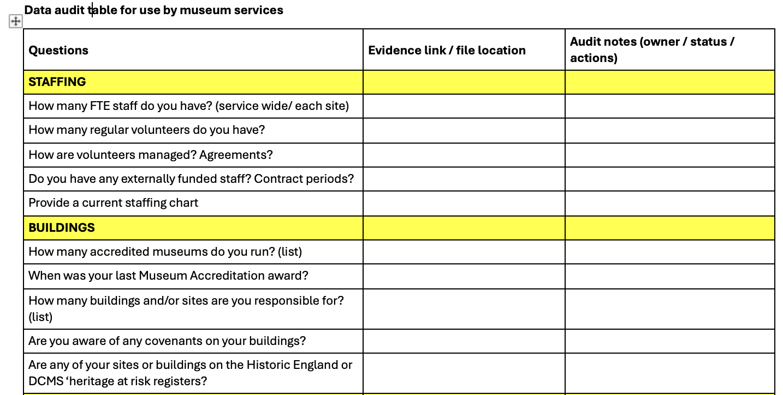
Shobana Jeyasingh – Seniors Workshop © Jason Thompson

Slide 19
2b. Service data audit - collections
Ensure you have up to date knowledge around the museum collections, including:
Information about documentation systems and contracts.
Clarity around collection ownership, including understanding around loan agreements in and out of the museum.
Buildings used by the museum, including external stores.
Good inventory information to support any changes or disaggregation of collections (if not, identify gaps and include in risks).
An understanding of any geographical collecting areas specified in your collections development policy and if this is affected by local authority area changes.
Shobana Jeyasingh – Seniors Workshop © Jason Thompson

Slide 20
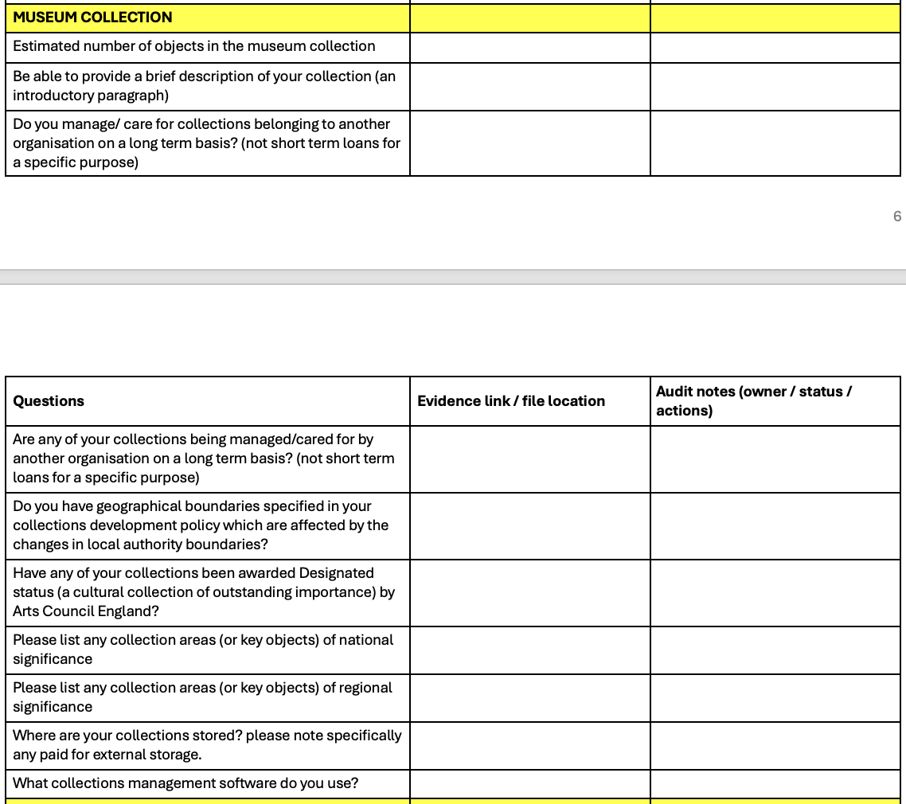
Shobana Jeyasingh – Seniors Workshop © Jason Thompson

Slide 21
2c. Service data audit – funding agreements and contracts
Understand contractual arrangements, timescales and conditions for funding agreements.
Arts Council England – NPO/ MEND
The National Lottery Heritage Fund
Grants provided for acquisitions
Any other funders
Arts Council England will issue its own guidance on updating of contracts
Shobana Jeyasingh – Seniors Workshop © Jason Thompson

Slide 22
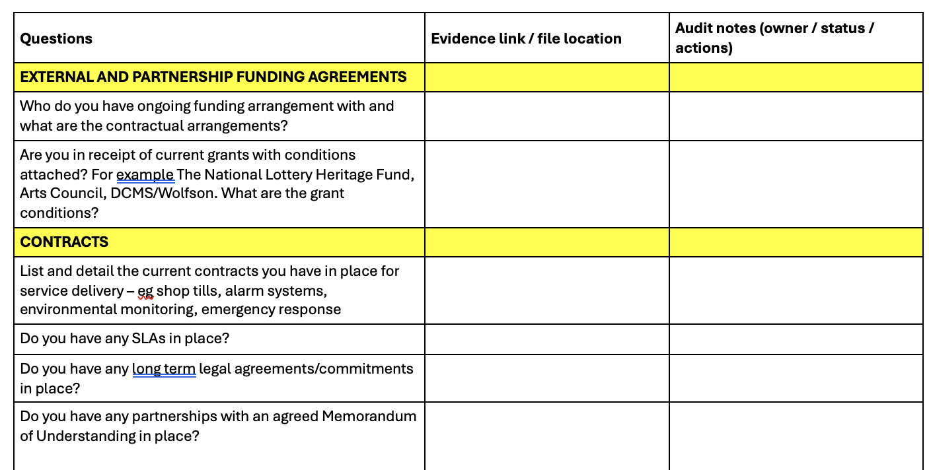
Shobana Jeyasingh – Seniors Workshop © Jason Thompson

Slide 23
3. Identify risks
There will be risk registers at different organisational levels, but having your own Service Risk Register and regularly reviewing it will help you articulate risks as services are planned. Safeguarding service delivery is a priority.
Example risks for museums include:
  Service delivery disrupted due to changes in contracts/partnerships.
  Distraction of key staff from core services as they respond to LGR planning.
  Disruption to insurance cover (and possible impact on GIS cover).
  Loss of data through systems fragmentation / lack of continuity.
  Disaggregation of collections and collections information.
  Break up of Designated collections.
  Loss of specialist staff knowledge.
  Unable to meet the Accreditation Standard.
  Breach of donor conditions.
  Future of county wide archaeology collections? Future collecting?.
Shobana Jeyasingh – Seniors Workshop © Jason Thompson

Slide 24
4. Manage change: workforce support
This is a big programme of change. Understandably people will be concerned about how this will impact their jobs, volunteer roles, work and visitors.
Keep listening and communicating and be open about where there are uncertainties. There will be opportunities to involve people in planning work as the process moves on.
Put LGR news / questions on regular meeting agendas
You are not alone – many colleagues in the authority are in a similar position. Use Museum Development and other networks for support / advice.
Shobana Jeyasingh – Seniors Workshop © Jason Thompson

Slide 25
5. Manage change: stakeholders
Your stakeholders will want to know what changes they can expect. Map your stakeholders so you can keep track and communicate with them regularly.
Stakeholders will range from your visitors, ‘Friends’ groups, schools and colleges, to sponsors and partners in the sector and wider community.
Have a plan to keep talking / keep updating.
Be realistic that you won’t have quick answers for everyone but there will be business as usual as the default.
Be ready to flag service critical issues / risks / formal relationships in the authority so they are not missed.
Shobana Jeyasingh – Seniors Workshop © Jason Thompson

Slide 26
6. Advocacy
Be ready to articulate the positive impact your museum(s) can have in the new authority: e.g. case studies, Museum Development Annual Museums Data Survey.
Look out for new strategic priorities.
Transition teams will set up workstreams – be part of the planning for your relevant workstreams.
Start to build relationships with elected members when shadow authorities are elected.
Museums will be a small part of the new authority, but make sure that you are articulating the positive impact of your services on the communities they serve and how museums help deliver council priorities.
Advocacy will be an ongoing task and will need you to build fruitful relationships with new colleagues.
Shobana Jeyasingh – Seniors Workshop © Jason Thompson

Slide 27
6a. Internal planning
The implementation of the new authorities will be carried out by elected members and officers. There will be Joint committees, an implementation executive and implementation team amongst others. A guide to this can be found here.
Museum services need to know who/which service is representing them in these meetings and make sure they are well briefed.
Shobana Jeyasingh – Seniors Workshop © Jason Thompson

Slide 28
7. Compliance with external standards
Maintain compliance with external standards (e.g. Accreditation, VAQAS, Spectrum) as a core part of delivering a high-quality service.
Build these requirements into planning and highlight any risks early. They can also support advocacy—for example, strengthening the case for collections management systems or appropriate building terms.
Shobana Jeyasingh – Seniors Workshop © Jason Thompson

Slide 29
7a. Museum Accreditation
Arts Council England will transfer Accreditation of museum sites to the new governing body - this may mean there is a period of Provisional Accreditation while the new arrangements bed in and key documents are updated to reflect the change.
Shobana Jeyasingh – Seniors Workshop © Jason Thompson

Slide 30
8. Planning for the future
Ensure you are up to date and understand the requirements around key compliance, including:
Museums’ specific GDPR and data sharing requirements. This covers collections data, and data you may collect for users and audience. Councils will be following the principles advised by the LGA.
Safeguarding - ensuring museum policies and procedures are understood and maintained.
Government indemnity - Government indemnity certification should be updated as part of the Local Government Reorganisation process. To ensure continued validity email Government.IndemnityScheme@artscouncil.org.uk with the indemnity number/s three months before transfer.
Shobana Jeyasingh – Seniors Workshop © Jason Thompson

Slide 31
9. Support
Local authority specific support: Local Government Association- LGR and Devolution Hub
Sector support: Arts Council England, Museum Development teams.
Culture: Guidance for Libraries and Archives , Community Leisure and UK and CLOA (Chief Cultural and Leisure Officers Association)
Local: Local authority colleagues, museum colleagues, forums and networks.
Shobana Jeyasingh – Seniors Workshop © Jason Thompson

Slide 32
9a. Case studies and learnings
SOCITM A survivor’s guide to LGR: includes officer insights from 2023 LGR in Cumbria and Somerset
Museum Development South East: LGR briefing page and resources
Making the most of your museums : a handbook for councillors : a 2019 LGA publication
Shobana Jeyasingh – Seniors Workshop © Jason Thompson

Slide 33
10a. Museums not operated by a LA
AUDIT WORK
Understand and quantify the support you currently receive; from financial to in kind (eg charitable rate relief top up, grants, professional advice).
Make sure you have copies of formal / legal agreements with the LA – e.g. lease agreement, funding agreement.
Do you have collection loans to/from the local authority?
Build relationships with shadow elected members once they are in place.
Be part of any local planning forums to demonstrate your value
Shobana Jeyasingh – Seniors Workshop © Jason Thompson

Slide 34
10b. Museums not operated by a LA
ADVOCACY
Refresh or review a clear single page document which explains what you do, who you are and some key impacts to share with new stakeholders.
Build relationships with shadow elected members once they are in place.
Be part of any local planning forums to demonstrate your value.
Work with MD to understand and promote the value that your service offers to the local area (use Museum Development Annual Survey data).
Shobana Jeyasingh – Seniors Workshop © Jason Thompson

Slide 35
10c. Museums not operated by a LA
CONTRACTS WITH LOCAL AUTHORITIES
Independent museums may have arrangements in place with local authorities around and including agreements around provision of premises, staff or services.
Understand and review the contractual arrangements in place and be prepared for possible updates.
Update your risk register to ensure all risks are managed appropriately.
Shobana Jeyasingh – Seniors Workshop © Jason Thompson

Slide 36
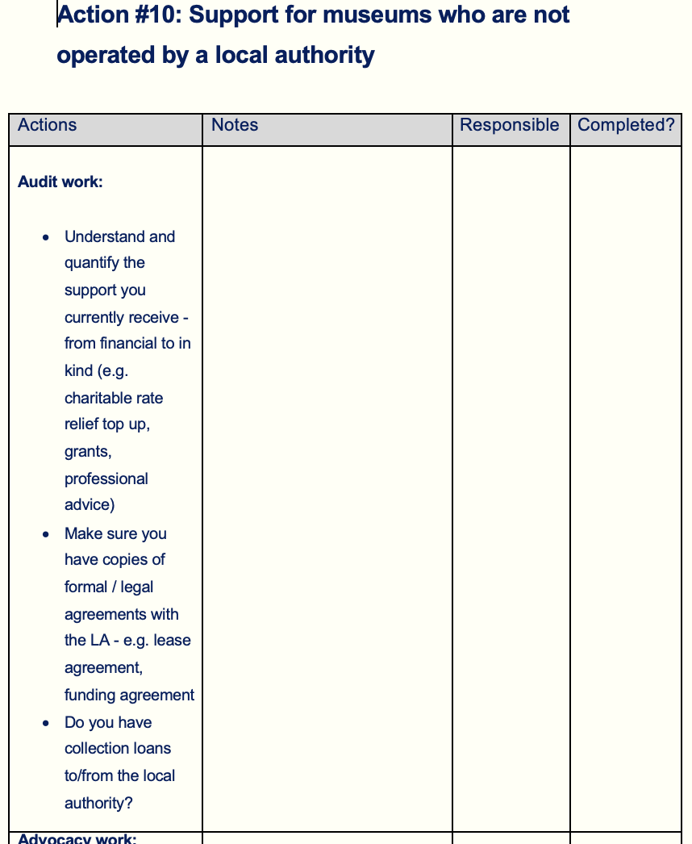
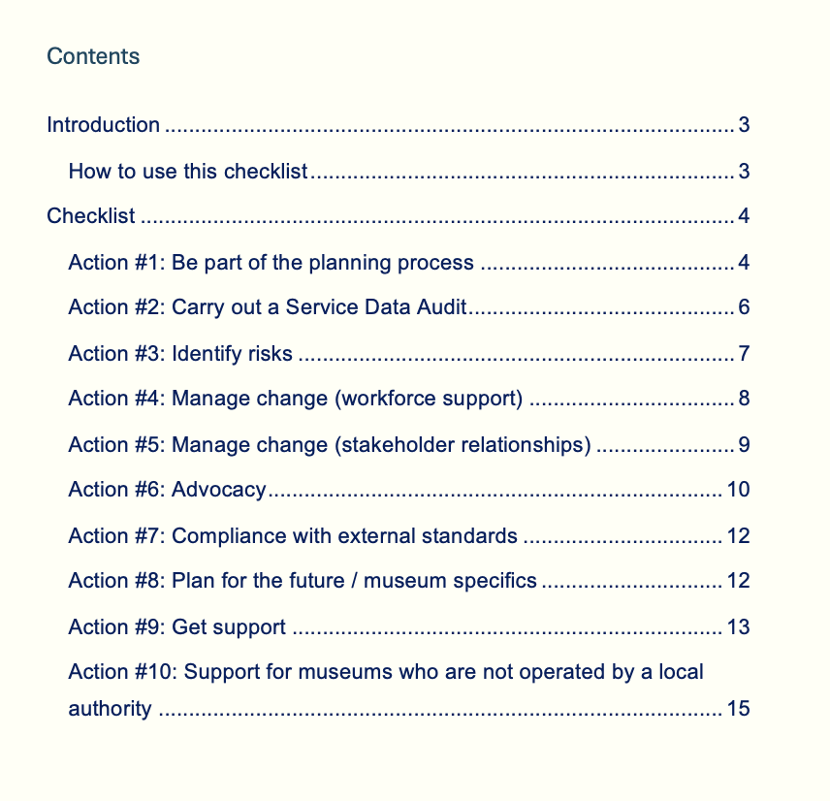

Shobana Jeyasingh – Seniors Workshop © Jason Thompson

Slide 37
Next steps
What can you do?
  Now – short term?
  Soon - medium term?
  Later – long term?
Shobana Jeyasingh – Seniors Workshop © Jason Thompson

Slide 38
Thank you

